Slide 1
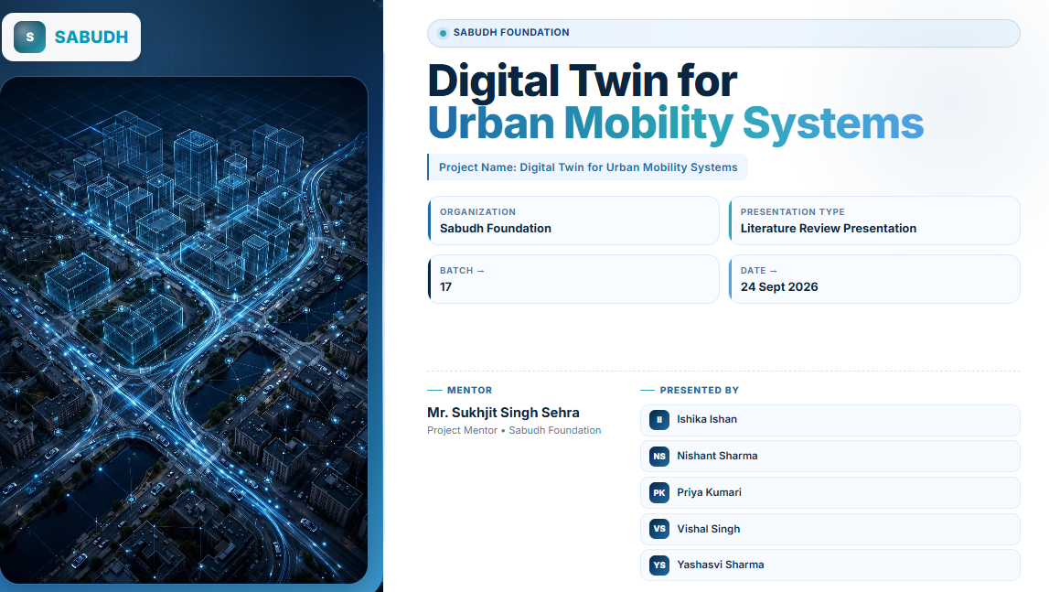

Slide 2
INTRODUCTION
Unified Digital Twin for Urban Transportation
Sense
→
Learn
→
Predict
→
Simulate
→
Decide
→
Evaluate
What it is
What it does
Our focus
A Digital Twin (DT) is a live virtual copy of a real transport system, built from data, models and simulation.
AI predicts what will happen; simulation tests what could happen if something changes.
One twin joining traffic, parking, public transport and electric vehicles (EVs).

Slide 3
2
Problem Statement Priya Kumari
Traffic twins
Mostly focus on traffic only
RESEARCH QUESTION
How can a unified Digital Twin combine traffic, parking, public transport and EV infrastructure to predict urban mobility conditions and test "what-if" scenarios?
Parking twins
Parking treated as a separate system
Public transport
Runs apart from road traffic
EV mobility
Weakly linked to other parts
Monitor + predict
Little what-if scenario testing
2 / 9

Slide 4
3
Problem Objective
1
2
3
Represent traffic, parking, public transport and EVs in one virtual environment
Collect real-time or simulated transport data
Predict future transport conditions
4
5
6
Detect likely congestion or parking problems
Run what-if scenarios such as a blocked road or a demand surge
Compare conditions before and after a proposed change
3 / 9

Slide 5
4
Motivation Yashasvi
75%+
20,000+
of them published after 2021: a fast-growing field
vehicles simulated in one city-scale twin
Frøyen et al.
Yeon et al., DTUMOS
Real-world experiments on roads are costly and risky; a twin lets cities test ideas safely first.
Changes in one system spill over into others: a road closure affects transit, parking and EV charging.
Edge AI and federated learning now make it possible to learn from private data without sharing it.
4 / 9

Slide 6
5
Area of Application Vishal
●
Traffic management
●
Parking management
●
Public transport
Congestion detection, signal control, roundabout metering
Demand prediction and parking-facility planning
Route changes and travel-time impact
●
EV charging & energy
●
Fleet & ride-hailing
●
Urban policy planning
Charging demand, grid load and energy-aware planning
ETA, ride matching and vehicle dispatching
Test road closures, new roads and policies before building
5 / 9

Slide 7
6
Papers Read
Chu et al. (2025): Async federated learning for DT IoT networks
Wang W. et al. (2023): Edge intelligence for traffic DTs
Zhao et al. (2026): FedSTAST trajectory prediction
Yeon et al. (2023): DTUMOS city-scale mobility twin
Caserta study: DT for parking and mobility forecasting
Rzeszów study: Roundabout DT and adaptive inflow metering
Lagos study: DT-driven mobility and predictive maintenance
Frøyen et al. (2025): Review of DTs for transport planning
Jiang & Luo (2022): GNNs for traffic forecasting: survey
Wang et al. (2024): STGformer traffic forecasting
Lin et al. (2023): TransETA arrival-time prediction
Rashid et al. (2024); Alaraj et al. (2025): EV charging demand forecasting reviews
Wang et al. (2025); Jing et al. (2025): Ride matching and federated dispatching
Xing et al. (2026): FGDT fine-grained twin migration
Zhou et al. (2025): DT + LSTM + PSO for energy and transport
Poorzare et al. (2025): Network Digital Twin survey
6 / 9

Slide 8
7
Techniques and Tools Nishant Sharma
Digital twin & simulation
Forecasting models
ETA & routing
DTUMOS, CARLA, traffic simulation software, real-time data integration
LSTM, GRU, GCN/GNN, Transformers, STGformer, ASTGCN
TransETA (GCN + Deep Forest + Transformer), shortest-path routing
Privacy & edge learning
Decision & optimization
Standards & platforms
Federated learning, asynchronous FL, edge computing
Reinforcement learning (PPO, Double DQN), PSO/MOPSO, Lyapunov, bandits
FIWARE, ITU-T Y.3090, IoT, GPS and camera data
7 / 9

Slide 9
8
Expected Outcomes Ishika Ishan
A working unified twin that represents traffic, parking, public transport and EVs together.
Predictions of traffic, parking demand, travel time and EV charging demand.
Early warning of congestion and parking problems.
A what-if tool with before/after comparison for road blockages, demand surges and route changes.
Evidence to support data-driven city planning decisions.
HOW WE WILL MEASURE
Travel time and delay
ETA error (MAE)
Waiting time
Energy use and charging use
Simulation time
Scalability
8 / 9

Slide 10
9
Literature References
[1] S. Chu et al., "Resource efficient asynchronous federated learning for digital twin empowered IoT network," IEEE Trans. Green Commun. Netw., 2025, doi:10.1109/TGCN.2025.3574143.
[2] W. Wang et al., "Data information processing of traffic digital twins in smart cities using edge intelligent federation learning," Inf. Process. Manage., 60(2), 103171, 2023.
[3] Y. Zhao et al., "Federated learning intersection vehicle trajectory prediction scheme within digital twin," IEEE Trans. Intell. Transp. Syst., 27(5), 6168–6180, 2026.
[4] H. Yeon et al., "DTUMOS, digital twin for large-scale urban mobility operating system," Sci. Rep., 13, 5154, 2023.
[5] Frøyen et al., "Exploring digital twins for transport planning: a review," 2025.
[6] Jiang & Luo, "Graph neural network for traffic forecasting: a survey," 2022.
[7] Wang et al., "STGformer: efficient spatiotemporal graph transformer for traffic forecasting," 2024.
[8] Lin et al., "TransETA: transformer networks for estimated time of arrival with local congestion representation," 2023.
[9] Rashid, Elfouly & Chen, "A comprehensive survey of electric vehicle charging demand forecasting techniques," 2024.
[10] Alaraj et al., "Machine learning-based EV charging demand forecasting: a systematized literature review," 2025.
[11] Wang et al., "Scalable ride-matching and dispatching model for shared autonomous electric vehicles with real-time demand prediction," 2025.
[12] Jing et al., "Scalable order dispatching through federated multi-agent deep reinforcement learning," 2025.
[13] L. Xing et al., "Fine-grained model-level digital twin migration method for intelligent transportation systems," IEEE Open J. Intell. Transp. Syst., 7, 565–583, 2026.
[14] Z. Zhou, Y. Li, Y. He, "Leveraging digital twins for integrated energy and transportation management in smart cities," IEEE Access, 13, 153024–153034, 2025.
[15] R. Poorzare et al., "Network digital twin toward networking, telecommunications, and traffic engineering: a survey," IEEE Access, 13, 2025.
[16] Caserta parking, Rzeszów roundabout and Lagos mobility digital twin studies (Research Papers 1–3).
9 / 9

